Slide 1
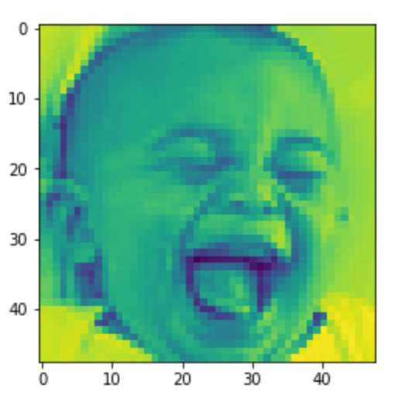
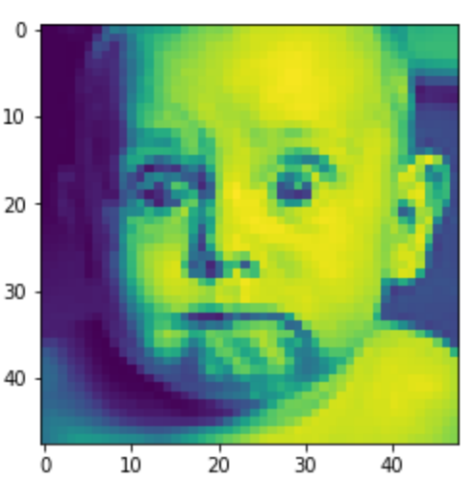
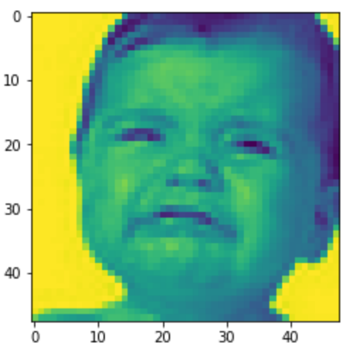
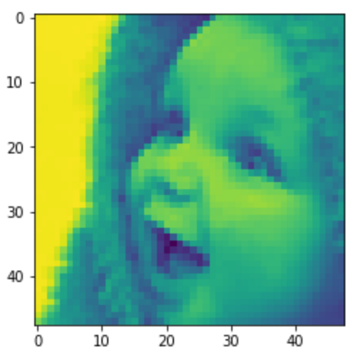
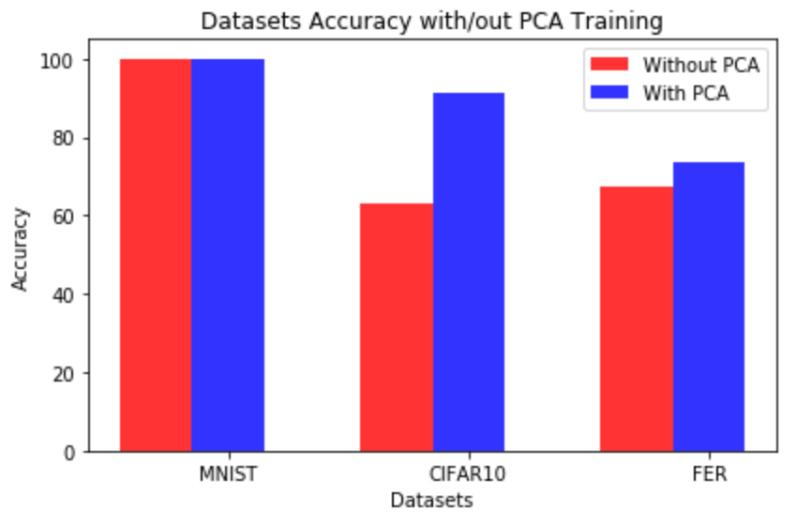
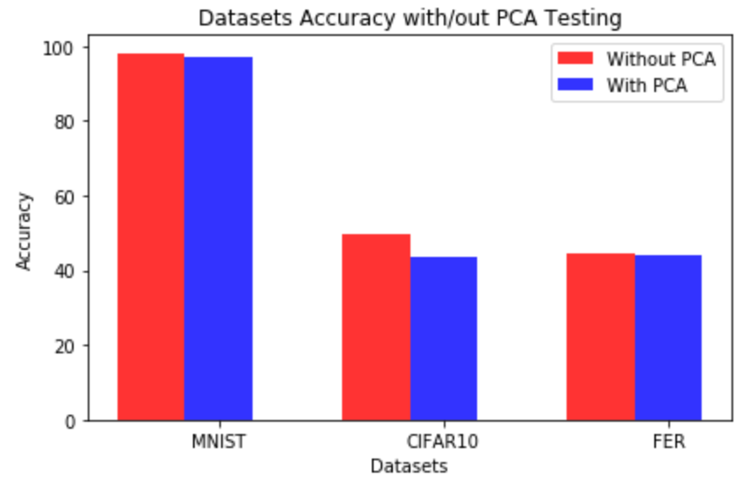
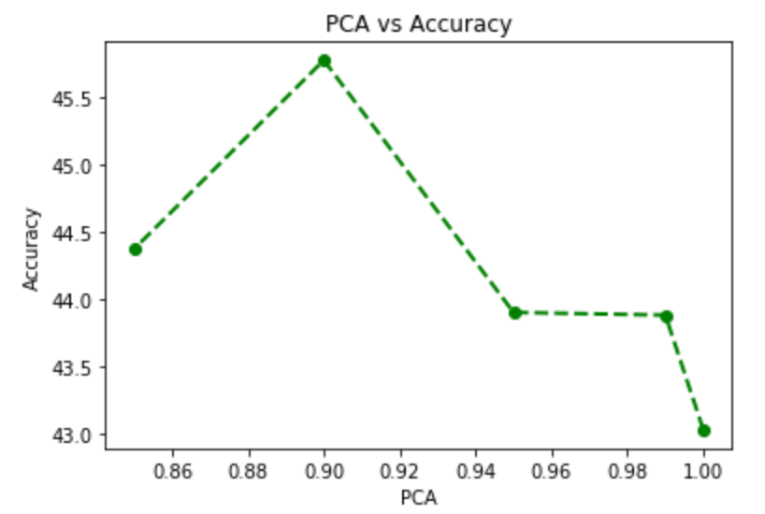
Facial Expression Recognition using 3-layered Neural Network
Labels:
0=Angry, 1=Disgust, 2=Fear, 3=Happy, 4=Sad, 5=Surprise, 6=Neutral
Datasets:
MNIST, CIFAR-10, Facial Expression
Presented By: Ashok Kumar Shrestha
Source: https://www.kaggle.com/c/challenges-in-representation-learning-facial-expression-recognition-challenge/data

